Slide 1
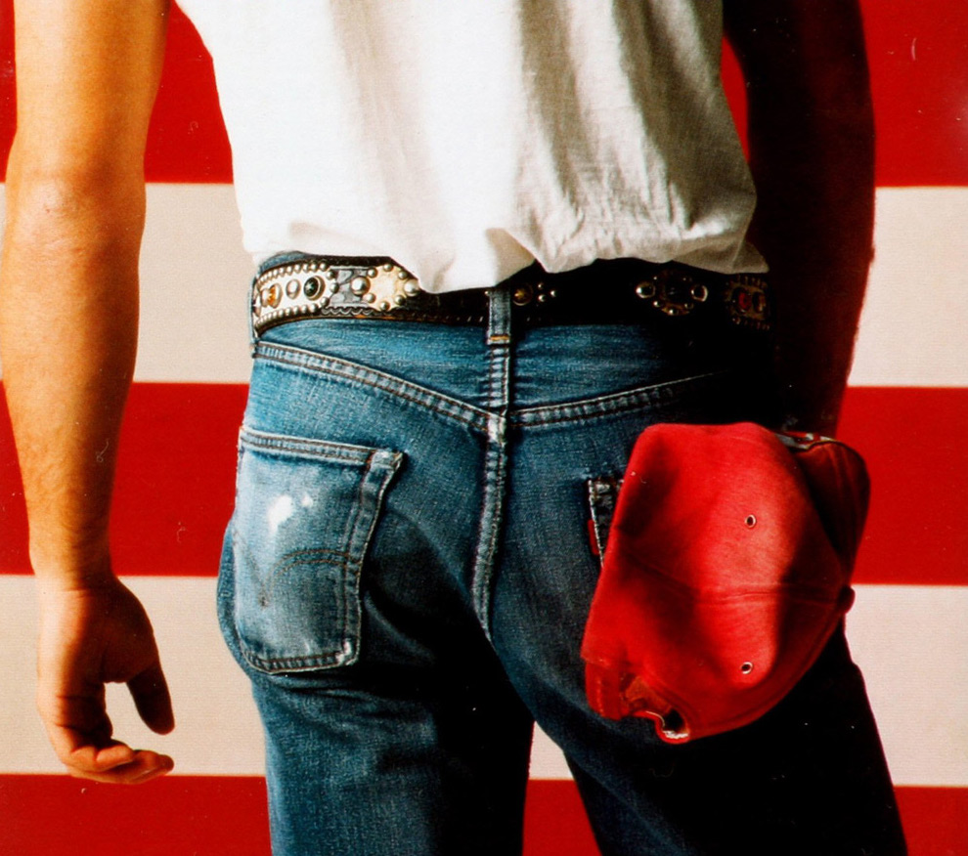
BEERS IN THE USA

Slide 2
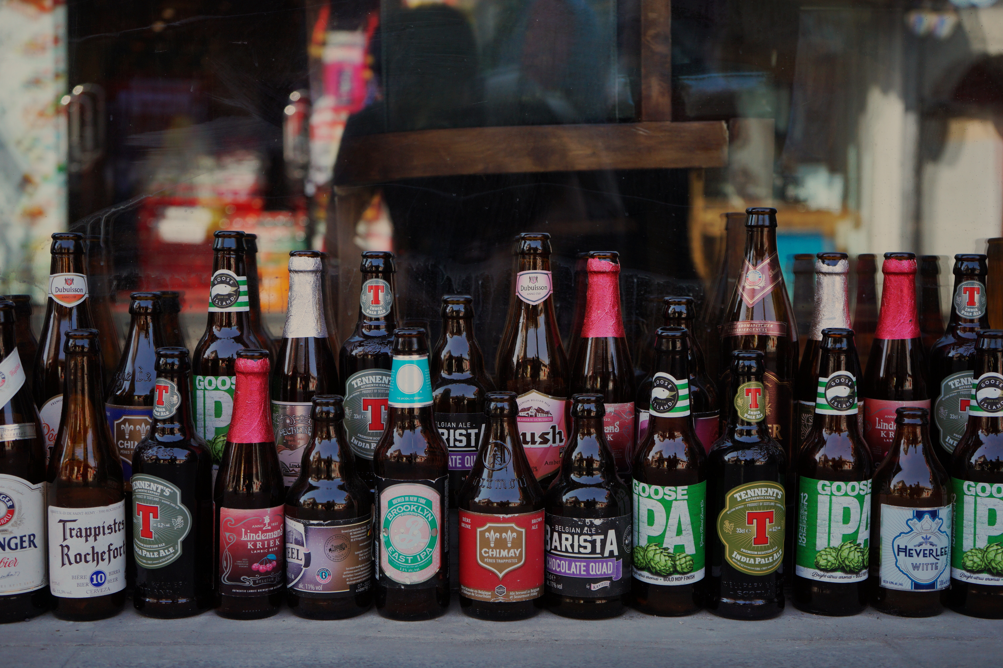
Introduction
This is a temporary place holder
This PPT should guild us through the 20 minute presentation
The backgrounds are optional (and editable), but I thought they’d add some lightness to the process.

Slide 3
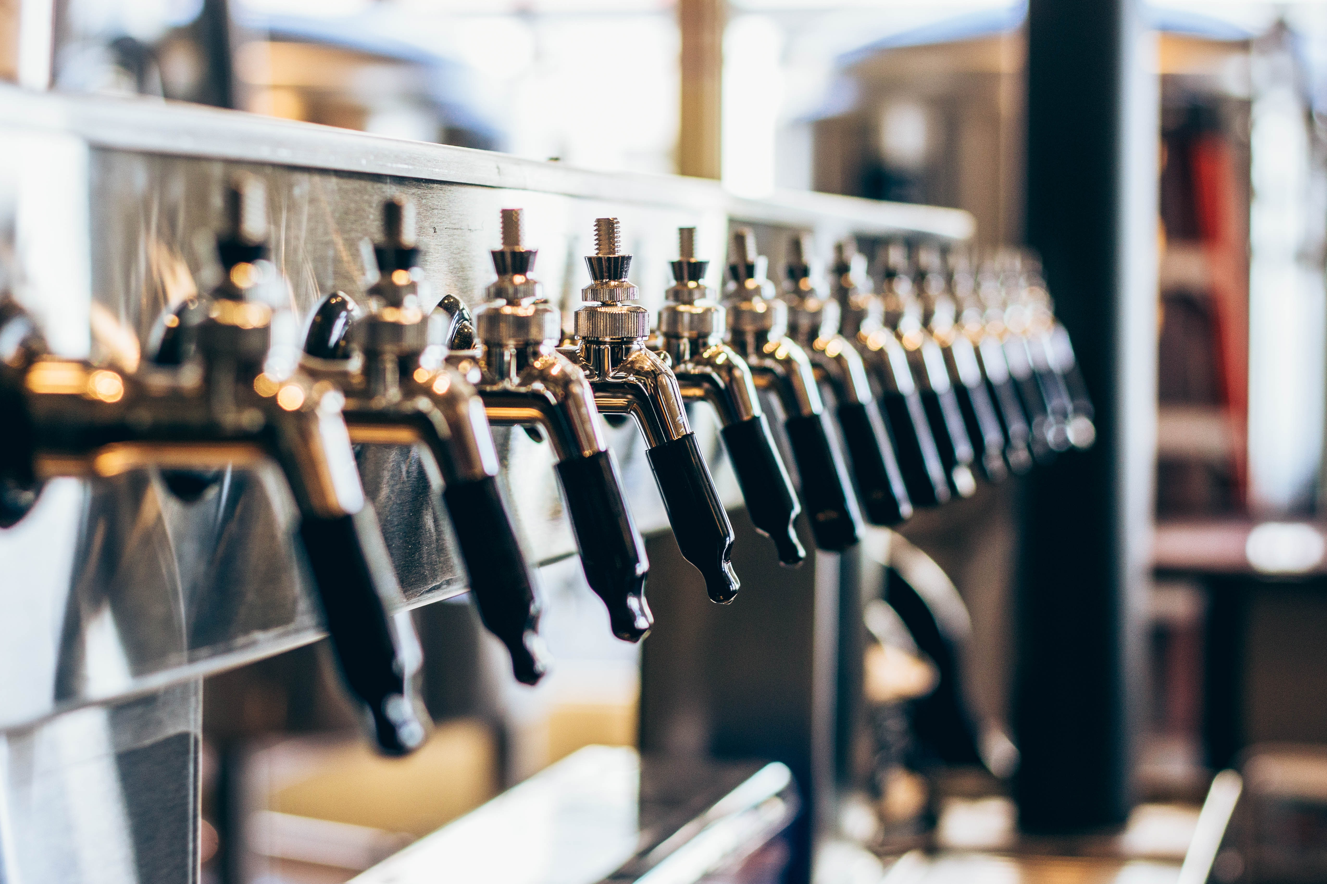
Our Process

Slide 4
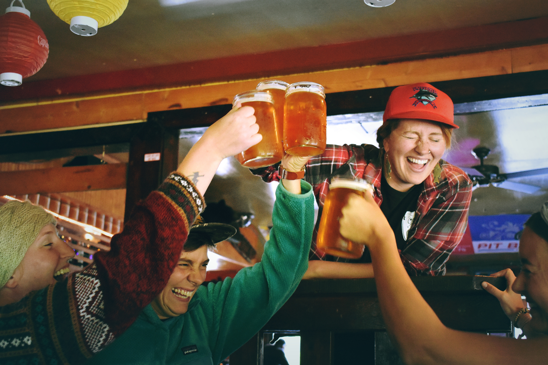
Results

Slide 5
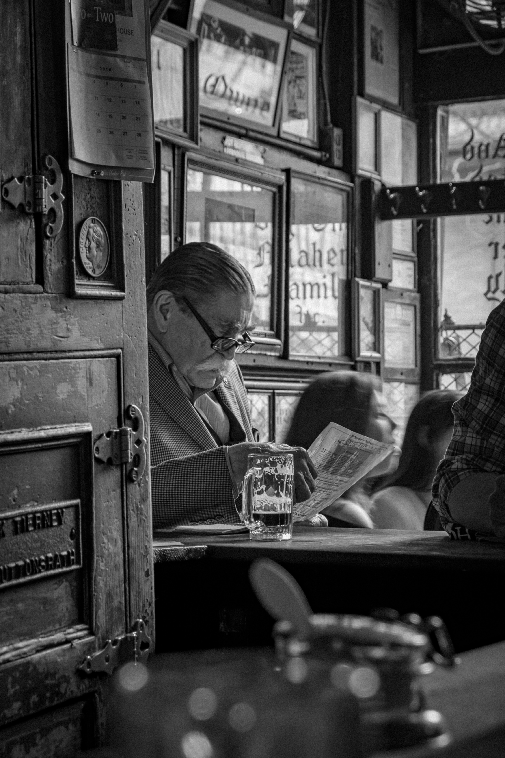
Conclusion

